Slide 1
Variances/HACCP/Specialized Processes
HaCcp IN
Retail Food Establishments
Notes:
Welcome and Introductions
Bathrooms/Breaks
Sign up Sheet
Will send Slide deck & handouts
Validated parking
More than 15 people

Slide 2
Please fill out name tent
Name
Municipality
# of Years you have done Food Inspections
Notes:
Do Introductions

Slide 3
Ground Rules
Share the air
Be. Here. Now.
No sidebar conversations
Respect/celebrate differing opinions
(Don’t) Talk to the Hand
Notes:
Vote

Slide 4
Capturing Questions/Ideas
Use Parking Lot for questions to be addressed later
Log Key Learnings/Ideas to use in the future

Slide 5
Learning Objectives
At the end of this session, you will be able to:
Identify activities that require Variance
Identify activities that require a HACCP plan
Assess a HACCP plan in writing and practice
Assess TPHC procedures in writing and practice
Locate and cite the Regulatory Applications of HACCP requirements from 105 CMR 590 and the 2013 Food Code

Slide 6
4 Concepts
Variances
Specialized Processes
HACCP
TPHC
Notes:
List all possibilities
List all combinations
Specialized processes that do not require a variance
Specialized processes that require a HACCP plan but no variance
TPHC

Slide 7
What is a Variance?
Variance means a written document issued by the Regulatory Authority (RA) that authorizes a modification or waiver of one or more requirements of Merged Food Code if, in the opinion of the RA, a health hazard or nuisance will not result from the modification or waiver.
Note: The variance is contingent upon control of potential health hazards that may occur as a result of the modification (e.g. HACCP plan)

Slide 8
Regulation: 590.008; 8-103.10 Modiﬁcations and Waivers
The regulatory authority may grant a variance by modifying or waiving the requirements of this Code if in the opinion of the regulatory authority – a health hazard or nuisance will not result from the variance. If a variance is granted, the regulatory authority shall retain the information speciﬁed under§ 8-103.11 in its records for the food establishment.
TIER 2 FOOD
8
Notes:
Proper citation starts with 590.008
Have you granted a variance for reasons other than HACCP plans in your office?
We issue a permit if you comply with the Code
An approved variance is required when a retail food establishment chooses to use a process/control
measure outside of Food Code requirements (e.g. curing, sprouting beans)

Slide 9
Regulation: § 8-103.11 Documentation of Proposed Variance and Justiﬁcation
Before a variance from a requirement of this Code is approved, the information that shall be provided by the person requesting the variance and retained in the regulatory authority’s ﬁle on food establishment includes:
A statement of the proposed variance of the Code requirement citing relevant Code section numbers;
An analysis of the rationale for how the potential public health Hazards and nuisances addressed by the relevant Code sections will be alternatively addressed by the proposal; and
A HACCP plan if required as speciﬁed under § 8-201.13(A) that includes the information speciﬁed under § 8-201.14 as it is relevant to the variance requested.
TIER 2 FOOD
9
Notes:
B: These risks are generally controlled with HACCP plan for Specialized processes
Some jurisdictions may grant variances for Specialized processes so rarely, they may not have an active process
Will send sample request form

Slide 10
Specialized Processes
Special Processes is a term used to describe processes or procedures, often using unusual technologies or equipment; that are not fully addressed in the Food Code.
Special Processes can present a significant health risk if not conducted under strict operational procedures.
Special Processes are usually conducted in processing/manufacturing, but MAY be conducted at retail but with the strict operational procedure requirements – a food safety management system must be approved, and in place.
Notes:
E.g. rendering a TCS non-TCS happens often in Manufacturing, acidifying sushi rice is a relatively unusual case for Retail

Slide 11

Special Processes
Discussion
Can you name some of the specialized processes being conducted at retail establishments that require a HACCP plan?
11

Slide 12
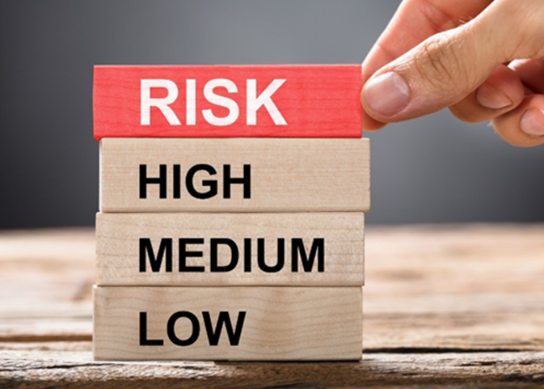
Notes:
List all possibilities
List all combinations
Specialized processes that do not require a variance
Specialized processes that require a HACCP plan but no variance
TPHC

Slide 13
3 Levels of Risk
High: Variance AND HACCP
Medium: HACCP and NO Variance
Low: No HACCP and No Variance
Notes:
List all possibilities
List all combinations
Specialized processes that do not require a variance
Specialized processes that require a HACCP plan but no variance
TPHC

Slide 14
Specialized Processes or Operations Requiring a Variance
AND
A HACCP Plan

Slide 15
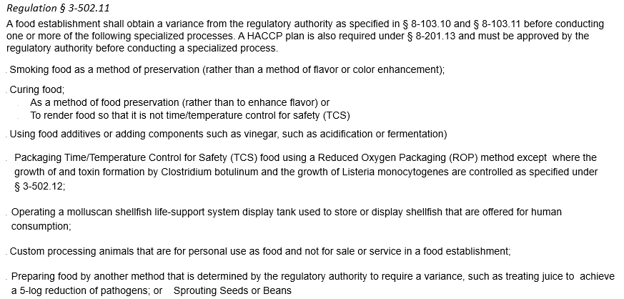
Specialized Processing Methods Requiring a Variance AND a HACCP Plan
TIER 2 FOOD
15

Slide 16
Require Variance and HACCP
Smoking food (for preservation)
Curing Food
Acidifying/fermenting food with additives (e.g. sushi)
Reduced Oxygen Packing (ROP) of TCS Foods (unless bacterial growth is otherwise controlled)
Molluscan Shellfish tank
Custom-processing animals for personal use
Sprouting seeds/beans
Notes:
How many establishments in your jurisdiction use these processes
'Preservation means extending shelf life of date-marked food beyond 7 days
What is concern with ROP? Used to extend shelf life
Sprouted bean outbreak happening now

Slide 17
Specialized Processes or Operations Requiring a HACCP Plan
But NO Variance
(unless required by jurisdiction)

Slide 18
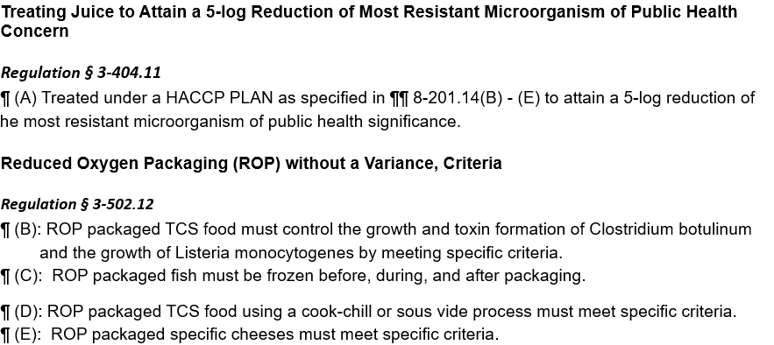
Specialized Processing Methods or Operations Requiring a HACCP Plan, but NO Variance
TIER 2 FOOD
18

Slide 19
Require HACCP but No Variance
Juice PACKAGED in establishment without a Warning label
ROP of raw meats, poultry and vegetables
ROP of fish (must be frozen before, during and after)
ROP of cheese (only hard and semi-soft cheeses)
ROP using Cook-chill
ROP using Sous Vide
Notes:
Note: Sous vide and cook-chill packages may not be sold to customers

Slide 20
'Packaged' definition
(1) "Packaged" means bottled, canned, cartoned, securely bagged, or securely wrapped, whether PACKAGED in a FOOD ESTABLISHMENT or a FOOD PROCESSING PLANT.
(2) "Packaged" does not include wrapped or placed in a carry-out container to protect the FOOD during service or delivery to the CONSUMER, by a FOOD EMPLOYEE, upon CONSUMER request.
Notes:
Packaged food requires a label
Packaged food is usually self-serve

Slide 21
'Juice' definition
(1) "Juice" means the aqueous liquid ex-pressed or extracted from one or more fruits or vegetables, purées of the edible portions of one or more fruits or vegetables, or any concentrates of such liquid or purée.
(2) "Juice" does not include, for purposes of HACCP, liquids, purées, or concentrates that are not used as BEVERAGES or ingredients of BEVERAGES.
Notes:
Fruit juices not TCS. Tell Odwalla story

Slide 22
Specialized Processes or Operations
That Do Not Require
A Variance or a HACCP Plan
Notes:
Regarding your question on Juice & HACCP:
Per FDA Food Cod – Annex 3 – Page 400: Labeling of Juice:
Retail establishments where packaged juice is made and only sold directly to consumers (such as juice bars) are not required to comply with this regulation. Rather, the Food Code requires fresh fruit or vegetable juices that are packaged at retail (untreated juices or beverages containing untreated juices that are offered to consumers as prepackaged foods) to be processed under HACCP with a 5 log reduction in pathogens of concern OR bear the warning statement as specified in 21 CFR Section 101.17(g). That statement is: “WARNING: This product has not been pasteurized and, therefore, may contain harmful bacteria that can cause serious illness in children, the elderly, and persons with weakened immune systems.”
Unpackaged juice (glasses of juice prepared at a juice bar, for example) does not require the 5 log reduction nor a warning statement or other consumer advisory (juice is not an animal food and therefore not covered by section 3-603.11) when prepared and served at retail. Usually the juice is served by the glass or in small batches compared to a commercial juice processor. The risk of using “drops” and damaged fruits or vegetables is much less at retail because of buyer specs that provide higher quality produce, meaning that fruits for juicing are less likely to be of a lower quality or damaged.

Slide 23
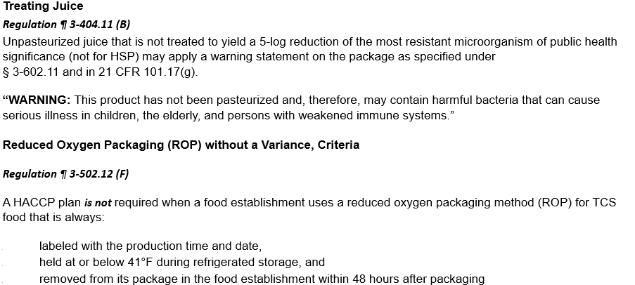
Specialized Processing Methods or Operations That DO NOT Require a Variance or a HACCP Plan
TIER 2 FOOD
23
Notes:
Can you think of some foods that you have seen ROP that do not need a HACCP plan?
If they need a hint: Think of Residential Kitchens.
Loaf breads, rolls, biscuits
• Cakes including celebration cakes • Pastries and cookies
• Candies and confections
• Fruit pies
• Jams, jellies and preserves
• Dried fruits
• Coffee beans Dry herbs, seasonings and mixtures
• Cereals, trail mixes and granola
• Coated or uncoated nuts
• Vinegar and flavored vinegars
• Popcorn, popcorn balls, cotton candy

Slide 24
Don't Require HACCP or Variance
Juice PACKAGED in establishment with a Warning label
ROP of Non-TCS Foods - Except fruit juice
ROP of TCS Foods IF food is always:
    Labeled with Production Time/date AND
    Held at 41F or below AND
    Removed from its package in the Establishment within 48 hours of packaging
Notes:
Warning label on juice must contain specific verbiage

Slide 25
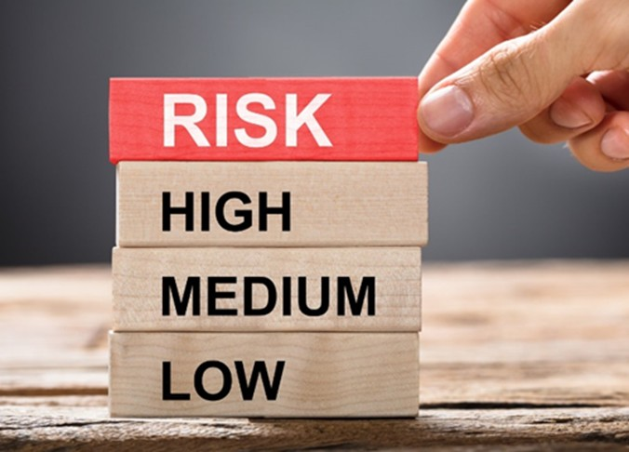
Is a Variance and/or HACCP
Plan Required?

Slide 26
Breakout Groups
Choose Team Name
Create Logo (bonus)
Draw Name and Logo on Placard
Notes:
Break into teams
Name teams

Slide 27
Instructions
For each of the following scenarios, indicate whether a variance, HACCP plan, and/or other special requirements are needed. (Choose all that apply.)
Please also report where you found the citation to back it up.
Response Options:
Variance required
HACCP plan required
Other Special Requirements
No Variance, HACCP Plan, or Other Special Requirement Needed
Notes:
Break into teams
Name teams

Slide 28

Scenario 1
A small orchard makes and bottles apple cider for sale to on-site customers only. They do not pasteurize the cider.
  Variance required
  HACCP plan required
  Other Special Requirements
28

Slide 29

Scenario 1
A small orchard makes and bottles apple cider for sale to on-site customers only. They do not pasteurize the cider.
  Variance required
  HACCP plan required
  Other Special Requirements
29

Slide 30
1. A small orchard makes and bottles apple cider for sale to on-site customers only. They do not pasteurize the cider.
Other Special Requirements
Answer: If they do not achieve a 5-log reduction in pathogens of concern according to Food Code Section 3-404.11 Treating Juice [also specified in 21 CFR 101.17(g)], they must place a warning statement on the label: “WARNING: This product has not been pasteurized and, therefore, may contain harmful bacteria that can cause serious illness in children, the elderly, and persons with weakened immune systems.”
Labeling requirements apply (3-602.11)

Slide 31
3-404.11 Treating Juice
JUICE PACKAGED in a FOOD ESTABLISHMENT shall be:
(A) Treated under a HACCP PLAN as specified in ¶¶ 8-201.14(B) - (E) to attain a 5-log reduction, which is equal to a 99.999% reduction, of the most resistant microorganism of public health significance; ^{P} or
(B) Labeled, if not treated to yield a 5-log reduction of the most resistant microorganism of public health significance: ^{Pf}
1. As specified under § 3-602.11, ^{Pf} and
2. As specified in 21 CFR 101.17(g) Food labeling, warning, notice, and safe handling statements, JUICES that have not been specifically processed to prevent, reduce, or eliminate the presence of pathogens with the following, “WARNING: This product has not been pasteurized and, therefore, may contain harmful bacteria that can cause serious illness in children, the elderly, and persons with weakened immune systems.” ^{Pf}
Notes:
You all have access to this document.

Slide 32

Scenario 2
A juice bar prepares orange-banana juice to order for individual customers.
  Variance required
  HACCP plan required
  Other Special Requirements
32

Slide 33
Scenario 2
A juice bar prepares orange-banana juice to order for individual customers.
  Variance required
  HACCP plan required
  Other Special Requirements
33

Slide 34
2. A juice bar prepares orange-banana juice to order for individual customers.
Answer: The juice is not packaged or bottled; therefore, neither a variance nor a HACCP plan nor special requirements are required.
Normal washing and culling of damaged or decayed fruit should be done before juicing but there are no special requirements.
Notes:
What ingredients are TCS in blended juices

Slide 35

Scenario 3
A store wants to vacuum package whole coffee beans and ground coffee with a shelf life of 6 months and sell to customers directly.
  Variance required
  HACCP plan required
  Other Special Requirements
35
Notes:
Nitrogen flush

Slide 36
Scenario 3
A store wants to vacuum package whole coffee beans and ground coffee with a shelf life of 6 months and sell to customers directly.
  Variance required
  HACCP plan required
  Other Special Requirements
36

Slide 37
A store wants to vacuum package whole coffee beans and ground coffee with a shelf life of 6 months and sell to customers directly.
Other Special Requirements
Answer: Coffee beans (ground or whole) are non-TCS because of their low water activity. Therefore, ROP requirements, including HACCP plan, variance and restrictions on shelf life, do not apply. Labeling requirements apply.
Notes:
Nitrogen flush

Slide 38
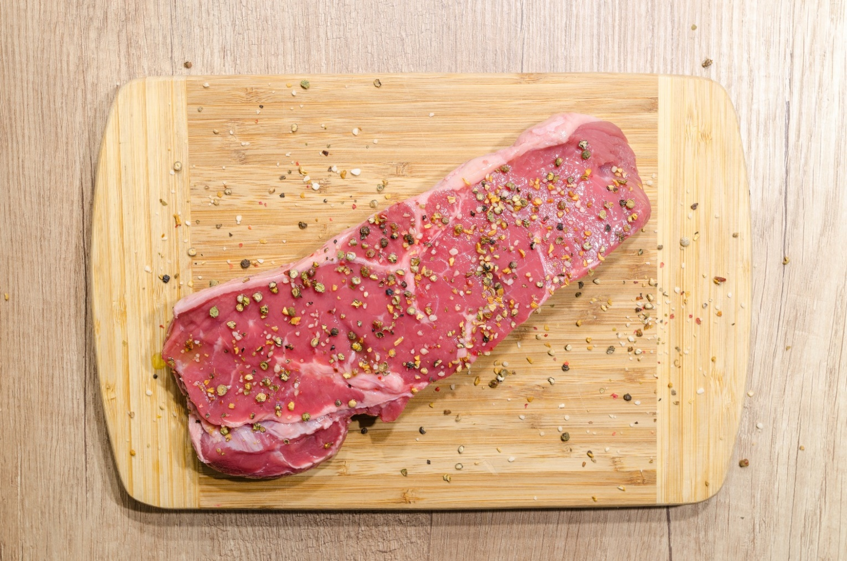
Scenario 4
A restaurant vacuum packages specially cut and marinated (raw) steaks for sale to their patrons.
  Variance required
  HACCP plan required
  Other Special Requirements
38

Slide 39
Scenario 4
A restaurant vacuum packages specially cut and marinated (raw) steaks for sale to their patrons.
  Variance required
  HACCP plan required
  Other Special Requirements
39

Slide 40
A restaurant vacuum packages specially cut and marinated (raw) steaks for sale to their patrons.
HACCP Plan and Special Requirements
Answer: Vacuum packaging is a form of ROP, therefore a HACCP plan is required under (3-502.12(B)(d)). High levels of competing organisms in raw meat provide a secondary barrier that allows the vacuum packaged steaks to be held at 41ºF without a variance for 30 days of packaging unless frozen, or the original manufacturer’s “sell-by” or “use-by” date, whichever occurs first.
They must also meet the other requirements of 3-502.12 (B) (3) – (7). These requirements must be stated in the HACCP plan, which must be provided to the REGULATORY AUTHORITY prior to implementation as specified under ¶ 8-201.13(B). Labeling requirements apply.
Notes:
Label: Maintain at 41F
Discard within 30 days (except when frozen)

Slide 41
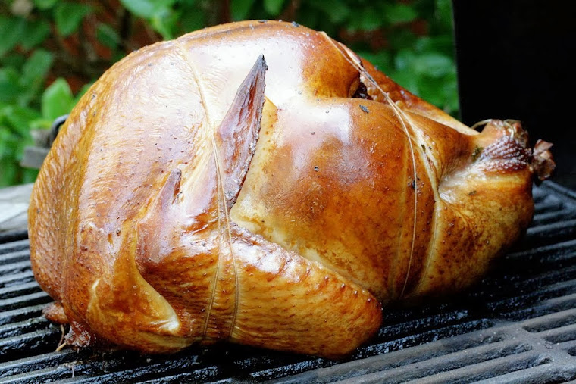
Scenario 5
A restaurant uses a small smoker to smoke turkey breasts to a final temperature of 175ºF in 7 hrs and served within 3 days
  Variance required
  HACCP plan required
  Other Special Requirements
41

Slide 42
Scenario 5
A restaurant uses a small smoker to smoke turkey breasts to a final temperature of 175ºF in 7 hrs.
  Variance required
  HACCP plan required
  Other Special Requirements
42
Notes:
Preservation extends shelf life past 7 days for Date Marked food

Slide 43
A restaurant uses a small smoker to smoke turkey breasts to a final temperature of 175°F in 7 hrs.
Other Special Requirements
Answer: Because the smoking process meets the required cooking temperature for poultry of 165°F for 15 seconds, no variance or HACCP plan is required. But the safety of the material (wood, sawdust, etc.) used to generate the smoke in the smoker must be verified.

Slide 44

Scenario 6
A restaurant buys alfalfa seed from a local farmer and soaks/irrigates the seed to grow fresh alfalfa sprouts for sandwiches and salads.
  Variance required
  HACCP plan required
  Other Special Requirements
44

Slide 45
Scenario 6
A restaurant buys alfalfa seed from a local farmer and soaks/irrigates the seed to grow fresh alfalfa sprouts for sandwiches and salads.
  Variance required
  HACCP plan required
  Other Special Requirements
45

Slide 46
A restaurant buys alfalfa seed from a local farmer and soaks/irrigates the seed to grow fresh alfalfa sprouts for sandwiches and salads.
Variance and a HACCP Plan Required
Answer: Under 3-502.11 (H) Variance Requirement a FOOD ESTABLISHMENT shall obtain a VARIANCE from the REGULATORY AUTHORITY as specified in § 8-103.10 and under § 8-103.11 before sprouting seeds or beans.
Key elements of the HACCP plan should include using seed intended for human consumption (GAPs), disinfecting the seed with 20,000 ppm Ca hypochlorite, testing the irrigation water for pathogens and refrigeration of the sprouts at 41ºF or less. See FDA Guidance for Industry: Reducing Microbial Food Safety Hazards for Sprouted Seeds.
Notes:
Note: Micro Greens are not sprouts

Slide 47
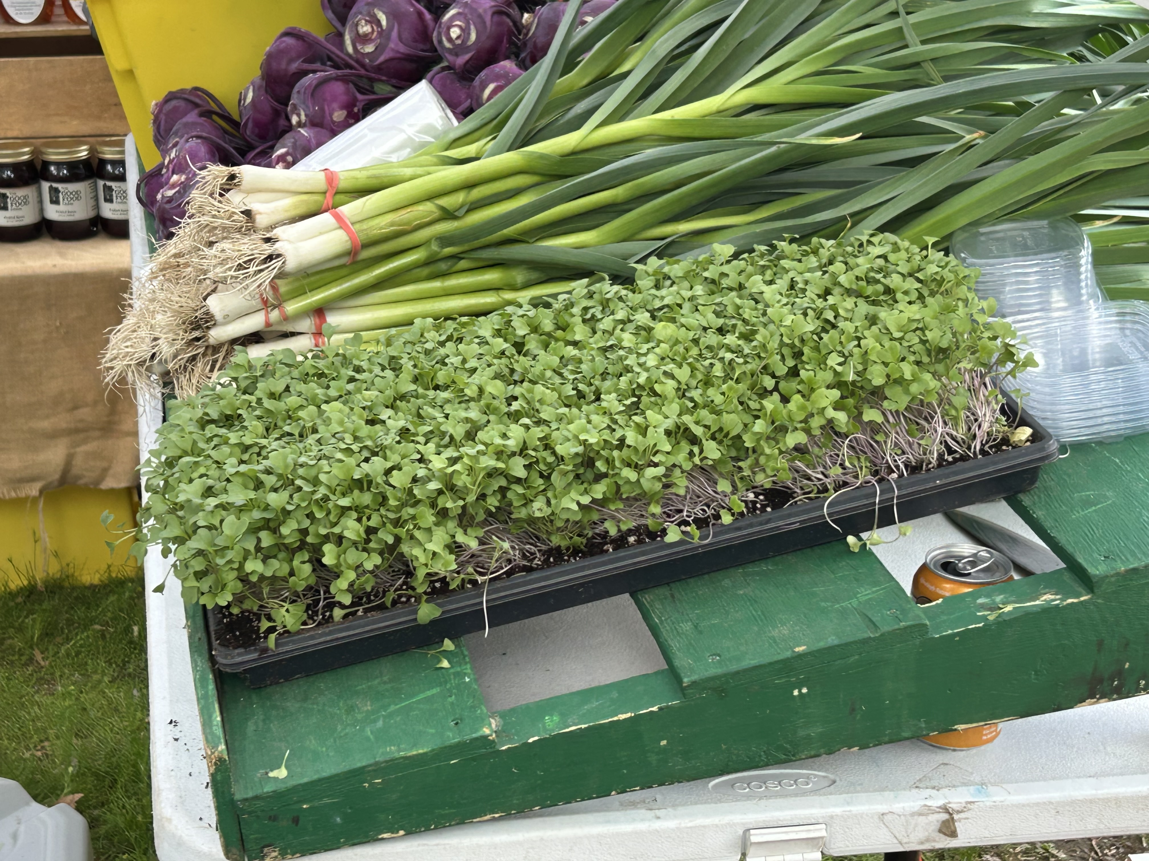
Microgreens are not Sprouts
Notes:
Vote

Slide 48
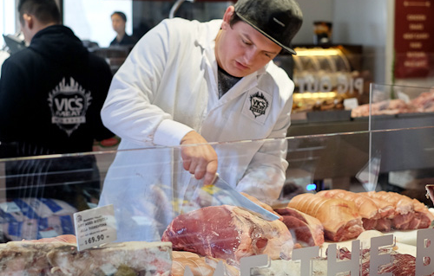
Scenario 7
A meat market smokes and cures Polish sausage where the final product temperature reaches 178°F after 24 hours.
  Variance required
  HACCP plan required
  Other Special Requirements
48
Notes:
Facilitator: The answer is continued on the next slide.

Slide 49
Scenario 7
A meat market smokes and cures Polish sausage where the final product temperature reaches 178°F after 24 hours.
  Variance required
  HACCP plan required
  Other Special Requirements
49
Notes:
Facilitator: The answer is continued on the next slide.

Slide 50
A meat market smokes and cures Polish sausage where the final product temperature reaches 178°F after 24 hours.
Variance, HACCP Plan, and Other Special Requirements
Answer: Since the smoking process reaches a temperature above the required cooking temperature for comminuted meat, no variance or HACCP plan is required because of the smoking. The source of the materials used to generate the smoke must be verified for safety though.
Notes:
Curing always requires Variance/HACCP

Slide 51
Scenario 7: Special Requirements
But the curing process is for preservation and to extend shelf life. Therefore under 3-502.11 (A)Variance Requirement a FOOD ESTABLISHMENT shall obtain a variance from the regulatory authority and submit a HACCP plan as specified in § 8-103.10 and under § 8-103.11 before curing FOOD as a method of FOOD preservation rather than as a method of
flavor enhancement.
Special requirements for curing comminuted sausage include: additives for curing must be approved for their intended use such as nitrates and nitrites for fixing color and cure accelerators such as ascorbates or erythorbates to speed the reaction, accurate measure of curing compounds must be done on a certified scale if not using pre-weighed packets, good mixing must be done for uniform distribution of curing compounds in the mix, curing must be done at ≤ 41ºF, final concentration of nitrite must be ≤ 200 ppm, and the label of the packaged product must show curing additives in the ingredient statement along with other necessary labeling information. Refer to the HACCP Guide from MA DPH for details.

Slide 52
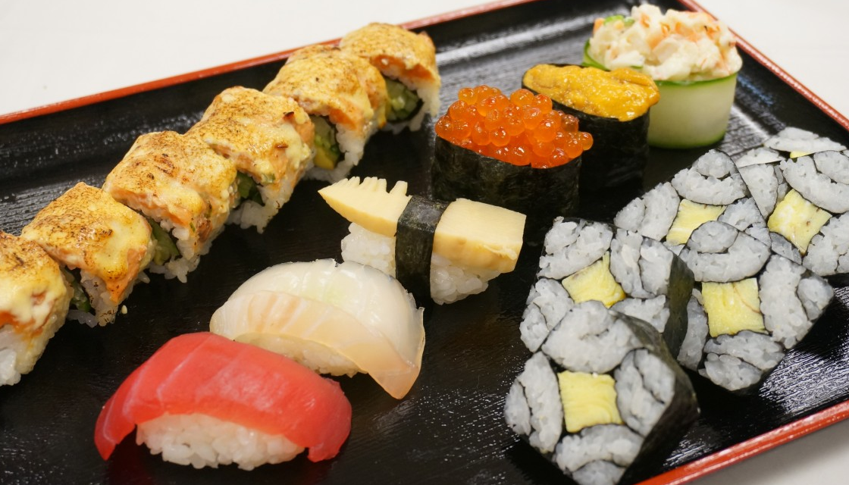
Scenario 8
A sushi bar acidifies their hot sushi rice to pH 4.1 with sweetened rice wine vinegar early in the morning and holds it at room temperature until it is used in the afternoon to make sushi rolls with raw vegetables, cooked shrimp, or cooked lobster for individual orders at lunch time.
  Variance required
  HACCP plan required
  Other Special Requirements
52

Slide 53
Scenario 8
A sushi bar acidifies their hot sushi rice to pH 4.1 with sweetened rice wine vinegar early in the morning and holds it at room temperature until it is used in the afternoon to make sushi rolls with raw vegetables, cooked shrimp, or cooked lobster for individual orders at lunch time.
  Variance required
  HACCP plan required
  Other Special Requirements
53

Slide 54
A sushi bar acidifies their hot sushi rice to pH 4.1 with sweetened rice wine vinegar early in the morning and holds it at room temperature until it is used in the afternoon to make sushi rolls with raw vegetables, cooked shrimp, or cooked lobster for individual orders at lunch time.
Variance and HACCP Plan Required
Answer: Under 3-502.11 Variance Requirement a FOOD ESTABLISHMENT shall obtain a variance from the regulatory authority and submit a HACCP plan as specified in § 8-103.10 and under § 8-103.11 before Using FOOD ADDITIVES or adding components such as vinegar as a method of FOOD preservation rather than as a method of flavor enhancement, or to render a
FOOD so that it is not TIME/TEMPERATURE CONTROL OF SAFETY FOOD.

Slide 56

Administrative Provisions

Slide 57
History of Hazard Analysis and Critical Control Plan (HACCP)
1959 The Pillsbury Company, US Army Natick Laboratories and the National Aeronautics and Space Administration (NASA) began developing the HACCP System
First presented to the public in 1971 at the National Conference on
Food Protection.
Initial HACCP (HACCP 1.0) Consisted of three principles:
Identification and assessment of hazards associated with growing/harvesting to marketing/preparation
Determination of the critical control points to control any identifiable hazard.
Establishment of systems to monitor critical control points.
Notes:
Two principal safety issues with which NASA was concerned:
Potential problems with food particles and water in a space capsule under conditions of zero gravity.
The need for absolute assurance that microbial pathogens or toxins were not present in foods produced for the space program.

Slide 58
History of HACCP (Cont’d)
Early 1970s FDA began training inspectors on all elements of HACCP and began HACCP inspections.
The low acid (21 CFR 113) and acidified foods (21 CFR 114) regulations that were promulgated in the early 1970s included HACCP-like concepts.
Little to no advancement until the mid 1980s
FDA Seafood HACCP – 1995
USDA Meat and Poultry HACCP – 1996
FDA Juice HACCP - 2001

Slide 59
7 HACCP Principles
1: Conduct a hazard analysis.
2: Determine the critical control points (CCPs).
3: Establish critical limits.
4: Establish monitoring procedures
5: Establish corrective actions.
6: Establish verification procedures
7: Establish record-keeping/documentation procedures
Notes:
Use sushi rice as an example
Verification includes Lab Validation
Otherwise Verification means Review logs and observe process. Review Plan annually. You serve as a Verification

Slide 60
HACCP Requirements
Permit Holder shall
Submit HACCP plan for approval
Comply with approved HACCP plan
    HACCP plan becomes part of the rule for the establishment

Slide 61
HACCP Requirements Under
MA Regulations and Food Code
Person-In-Charge
Demonstrate knowledge of application of HACCP principles
2-102.11 [590.002(B)]
If HACCP Plan is required:
Explain in detail the HACCP plan (2-102.11 (C)(15)
Designate food employee for monitoring and controlling of Critical Control Points (8-201.14 (D)(3)
Verification of HACCP plan (8-201.14 (D)(4)
Take corrective actions if CL is not met (8-201.14 (D)(5)
Maintain and provide HACCP records (8-201.14 (D)(6) and 590.008(K)(B)(2)(e) and f (See 8-403.10)

Slide 62
Prerequisite Programs
Develop SOPs
Prerequisite
Procedures to prevent cross contamination
Personal hygienic practices
Pest Control System
Vendor Certification Program
Staff Training Program
Refrigeration Temperature Monitoring Program
Preventive Maintenance Schedule
Required
Employee Sick Policy - Requirement per 2-103.11 Person in Charge. [590.002(D)] “(O) FOOD EMPLOYEES and CONDITIONAL EMPLOYEES are informed in a verifiable manner of their responsibility to report in accordance with LAW, to the PERSON IN CHARGE, information about their health and activities as they relate to diseases that are transmissible through FOOD, as specified under ¶ 2-201.11(A). ^{Pf”}
Allergen Management Program - MA State Requirement per 105 CMR 590.011

Slide 63
Regulation: § 8-201.14
Contents of a HACCP Plan
For a FOOD ESTABLISHMENT that is required under § 8-201.13 to have a HACCP PLAN, the PERMIT applicant or PERMIT HOLDER shall submit to the REGULATORY AUTHORITY a properly prepared HACCP plan that includes:
(A) General information such as the name of the PERMIT applicant or PERMIT HOLDER, the FOOD ESTABLISHMENT address, and contact information;
(B) A categorization of the types of TIME/TEMPERATURE CONTROL FOR SAFETY FOODS that are to be controlled under the HACCP PLAN; Pf
(C) A flow diagram or chart for each specific FOOD or category type that identifies:
  Each step in the process; Pf
  The HAZARDS and controls for each step in the flow diagram or chart; Pf
  Steps that are CRITICAL CONTROL POINTS; Pf
  The ingredients, materials, and equipment used in the preparation of that FOOD, Pf and
  Formulations or recipes that delineate methods and procedural control measures that address the FOOD safety concerns involved; Pf
TIER 2 FOOD
63
Notes:
"Shall submit"
Critical Control Point: A point or procedure in a specific food system where loss of control may result in an unacceptable health risk.
Minimum requirements

Slide 64
Regulation: § 8-201.14
Contents of a HACCP Plan (Cont’d 2)
(E) Supporting documents such as:
(1) FOOD EMPLOYEE and supervisory training plan that addresses the FOOD safety issues of concern;^{Pf}
(2) Copies of blank records forms that are necessary to implement the HACCP PLAN; ^{Pf}
(3) Additional scientific data or other information, as required by the REGULATORY AUTHORITY, supporting the determination that FOOD safety is not compromised by the proposal. ^{Pf}
(F) Any other information required by the REGULATORY AUTHORITY.
TIER 2 FOOD
64

Slide 65
Regulation: § 8-201.14
Contents of a HACCP Plan (Cont’d)
D) A CRITICAL CONTROL POINT summary for each specific FOOD or category type that clearly identifies:
Each CRITICAL CONTROL POINT, ^{Pf}
The CRITICAL LIMITS for each CRITICAL CONTROL POINT, ^{Pf}
The method and frequency for monitoring and controlling each CRITICAL CONTROL POINT by the designated FOOD EMPLOYEE or PERSON IN CHARGE ^{Pf}
The method and frequency for the PERSON IN CHARGE to routinely verify that the FOOD EMPLOYEE is following standard operating procedures and monitoring CRITICAL CONTROL POINTS, ^{Pf}
Action to be taken by the designated FOOD EMPLOYEE or PERSON IN CHARGE if the CRITICAL LIMITS for each CRITICAL CONTROL POINT are not met, ^{Pf} and
Records to be maintained by the PERSON IN CHARGE to demonstrate that the HACCP PLAN is properly operated and managed; ^{Pf} and
TIER 2 FOOD
65

Slide 66
Acidified Sushi Rice HACCP Plan Contents
Hazard is Bacillus Cereus
Acidification of the rice is CCP
Recipe includes weight/volume of rice and water and strength of vinegar
PH of each batch of acidified rice must be verified using a calibrated (daily) pH meter or appropriate pH paper
  pH strips must be able to detect 0.1 unit differences in pH (increments of 0.3 or less)
Record-keeping to document pH, pH meter calibration and Corrective action
Sample log forms

Slide 67
Acidified Sushi Rice HACCP Plan Key Elements
If using pH paper, the pH shall not exceed 4.3
If using a pH meter, the pH shall not exceed:
    4.3 if tested within 2 hours of preparation, or
    4.6 if tested after 2 hours of preparation.
Lab validation updated annually or when recipe is modified
Signed and dated HACCP plan reviewed and updated at least annually or as needed by PIC.
Notes:
Annual lab validation may not be required in your jurisdiction

Slide 68
Acidified Sushi Rice HACCP Plan Key Elements
Supporting documents such as:
FOOD EMPLOYEE and supervisory training plan that addresses the FOOD safety issues of concern
PH meter calibration log
PH measurement log (retain for 30 days)
Validation by independent laboratory of acidification process. Redo if/when recipe changes
Also: Parasite destruction documentation

Slide 69
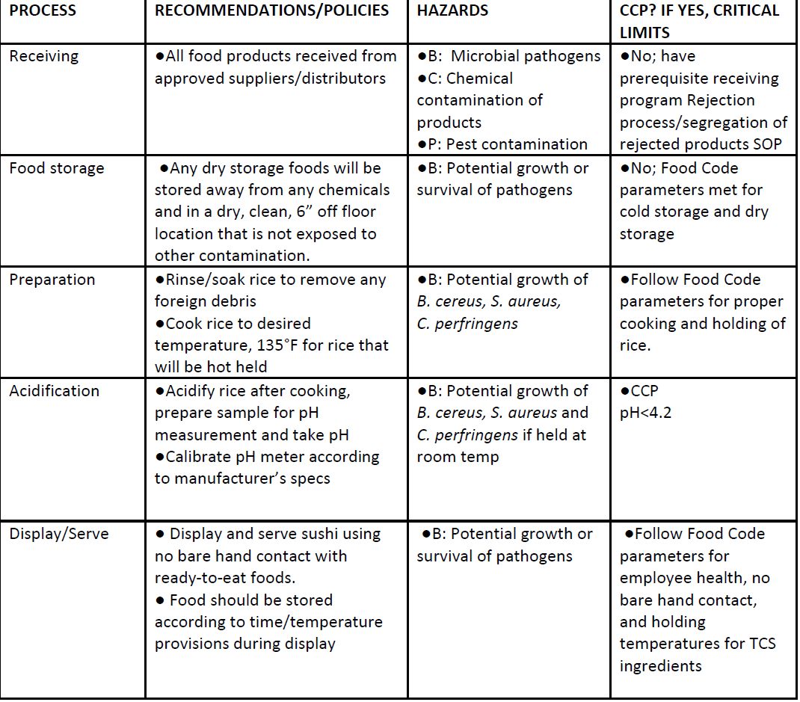
Sushi Rice Sample Process Flow Chart

Slide 70
Regulation: § 8-103.12
Conformance with Approved Procedures
If the regulatory authority grants a variance as speciﬁed in § 8-103.10, or a HACCP plan is otherwise required as speciﬁed under § 8-201.13, the permit holder shall:
(A) Comply with the HACCP plans and procedures that are submitted as speciﬁed under
§ 8-201.14 and approved as a basis for the modiﬁcation or waiver; and
(B) Maintain and provide to the regulatory authority, upon request, records speciﬁed under
§ 8-201.14(D) and (E) that demonstrate that the following are routinely employed;
  Procedures for monitoring critical control points,
  Monitoring of the critical control points,
  Veriﬁcation of the eﬀectiveness of an operation or process, and
  Necessary corrective actions if there is failure at a critical control point
TIER 2 FOOD
70
Notes:
Your inspections serve as a Verification step
In Tier 3 we schedule a HACCP validation inspection
What are your Common observed violations/tips

Slide 71
Breakout Session
FOOD DAY 5
Notes:
Select a scribe/spokesperson
What are common violations AND what are Inspection Tips and Tricks
70

Slide 72
Other HACCP Notes
HACCP plans in use at an establishment have been previously approved by your jurisdiction
Establishments with HACCP plans are Risk Level 4
No Specialized processes allowed in Residential kitchens (e.g hot sauce)
Notes:
HACCP establishments with excellent record of AMC can be Risk Level 3

Slide 73
Applicable Regulations - Specialized Processes or Operations Requiring a HACCP Plan
§ 3-404.11 Treating Juice Packaged in a Retail Food Establishment
§ 3-502.11 Variance Requirement – Specialized Processing Methods
§ 3-502.12 Reduced Oxygen Packaging Without a Variance, Criteria
§ 3-801.11 Pasteurized Foods and Prohibited Food in Highly Susceptible Populations
§ 8-103.10 Modiﬁcations and Waivers
§ 8-103.11 Documentation of Proposed Variance and Justiﬁcation
§ 8-103.12 Conformance with Approved Procedures
§ 8-201.13 When a HACCP Plan is Required
§ 8-201.14 Contents of a HACCP Plan

Slide 74
THE Resource
AFDO Guide
AFDO HACCP Plans for Specialized Processes at Retail
Notes:
Show AFDO Guide

Slide 75
Breakout Session
FOOD DAY 5
Notes:
FDA Code sections
HOW MUCH TIME SHOULD BE ALLOWED?
Provide instructions – handout.
Breakout Session: Writing Observations and Corrective Actions
Instructions:
Assign roles: Choose a scribe and a speaker.
Each group has 3 pictures in their folder to review.
Analyze each picture and identify the violation, being sure to note the observations and list both immediate and long-term corrective action.*
Record these answers on the large notepad.
Tape the completed answer sheet under the corresponding photo on the wall.
Designated speaker presents findings to the larger group.
*Please see the example below. It is not necessary to include the headings “immediate” or “long-term” in your response.
77

Slide 76
Time as a Public Health Control
3-501.19 (1) Written procedures shall be prepared in advance, submitted to the REGULATORY AUTHORITY for review, maintained in the FOOD ESTABLISHMENT and made available to the REGULATORY AUTHORITY upon request

Slide 77
Time as a Public Health Control
Maximum of 4 hours:
(1) The FOOD shall have an initial temperature of 41ºF or less when removed from cold holding temperature control, or 135°F or greater when removed from hot holding temperature control
(2) The FOOD shall be marked or otherwise identified to indicate the time that is 4 hours past the point in time when the FOOD is removed from temperature control

Slide 78
Time as a Public Health Control
(3) The FOOD shall be cooked and served, served at any temperature if READY-TO-EAT, or discarded, within 4 hours from the point in time when the FOOD is removed from temperature control and
(4) The FOOD in unmarked containers or PACKAGES, or marked to exceed a 4 hour limit shall be discarded

Slide 79
Time as a Public Health Control
A maximum of 6 hours
(1) The FOOD shall have an initial temperature of 41ºF or less when removed from temperature control and the FOOD temperature may not exceed 70ºF
(2) The FOOD shall be monitored to ensure the warmest portion of the FOOD does not exceed 70ºF during the 6-hour period, unless an ambient air temperature is maintained that ensures the FOOD does not exceed 70ºF

Slide 80
Time as a Public Health Control
The FOOD shall be marked or otherwise identified to indicate
(a) The time when the FOOD is removed from 41ºF or less cold holding temperature control and
(b) The time that is 6 hours past the point in time when the FOOD is removed from cold holding temperature control

Slide 81
Time as a Public Health Control
(3) The FOOD shall be cooked and served, served at any temperature if READY-TO-EAT, or discarded, within 6 hours from the point in time when the FOOD is removed from temperature control and
(4) The FOOD in unmarked containers or PACKAGES, or marked to exceed a 6-hour limit shall be discarded

Slide 82
TIER 2 FOOD

Slide 83
Next Steps
Please fill out Feedback form
Get Your Parking validated
I will email Presentation and other handouts
Let's Stay in touch!

